Slide 1


TASK MANAGER

Slide 2


ABOUT
JAVA
CONCEPT:- OOP
JAVAFX FRAMEWORK

Slide 3
JAVAFX CLASSES I USED IN THE PROJECT
BUTTONS
TEXT LABELS
TEXT FIELDS
VBOX
HBOX
BORDER PANE
LISTVIEW
COMBOBOX OR CHOICE BOX
GRIDPANE

Slide 4
BUTTONS
Buttons are one of the most fundamental UI controls in JavaFX. They are used to trigger actions or events when clicked by the user. JavaFX provides a Button class that can be customized with text, images, and various visual effects. You can add event handlers to buttons to perform specific actions when they are clicked.

Slide 5
TEXT LABELS
Text labels, represented by the Label class in JavaFX, are used to display static text or captions in the GUI. Labels are typically used to provide descriptions, instructions, or information to the user. You can set the text content, font, alignment, and other properties of labels to customize their appearance.

Slide 6
TEXTFIELDS
Text fields, represented by the TextField class, allow users to enter and edit text. They are commonly used for user input, such as entering names, passwords, or other textual information. Text fields provide methods for retrieving and manipulating the entered text, and you can attach event handlers to respond to user interactions or input validation.

Slide 7
VBOX AND HBOX
VBox and HBox are layout containers provided by JavaFX. VBox arranges its child nodes vertically, stacking them one on top of the other, while HBox arranges its child nodes horizontally, placing them side by side. These containers are used to organize and control the positioning of other UI controls within a scene or window. You can add various UI controls to VBox and HBox, and they will automatically adjust their layout based on the available space.

Slide 8
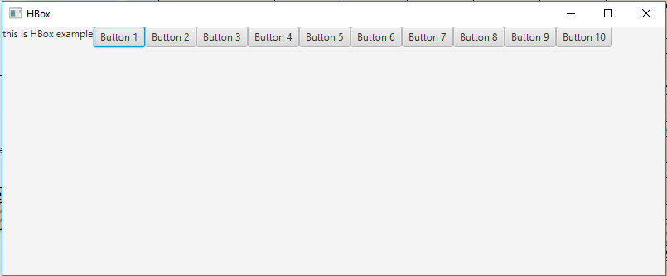
HBOX

Slide 9
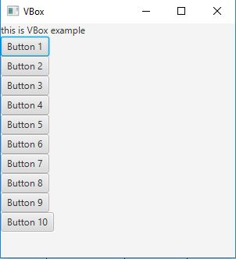
VBOX

Slide 10
BORDERPANE
BorderPane is another layout container in JavaFX that divides the available space into five regions: top, bottom, left, right, and center. It is commonly used as the root container for arranging the major components of a GUI. You can place UI controls in any of the regions, and BorderPane will handle the layout and resizing automatically.

Slide 11
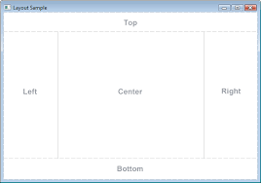
BORDER PANE EXAMPLE

Slide 12
LISTVIEW
ListView is a JavaFX control that displays a list of items, allowing users to select one or more items from the list. It provides methods for populating the list with data and handling selection events. ListView can be customized with different cell renderers to display complex data structures.

Slide 13
CHOICE BOX
ComboBox (or ChoiceBox) is a UI control that combines a button or a text field with a drop-down list. It allows users to choose an item from the list or enter custom text. ComboBox is often used for selecting options from a predefined list or providing autocompletion functionality.

Slide 14
GRID PANE
GridPane is a flexible layout container that arranges its child nodes in a grid-like structure, with rows and columns. It allows you to create complex and structured layouts by specifying the row and column indices for each UI control. GridPane provides methods for controlling the positioning, alignment, and spanning of child nodes within the grid.

Slide 15
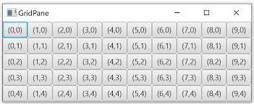
GRID PANE EXAMPLE

Slide 16
BASIC STRUCTURE OF ANY JAVAFX PROGRAMME
CREATE CONTROLS LIKE BUTTON ,TEXTFIELDS, LISTVIEWS E.T.C
INSERT THE CONTROLS TO A LAYOUT
YOU CAN ALSO CREATE MULTIPLE LAYOUTS WITH AS MANY CONTROLS YOU NEED
PLACE ALL THESE LAYOUTS INTO A SINGLE LAYOUT
YOU CAN ALSO ADD OTHER FUNCTONALITES TO BUTTONS OTHER CONTROLS BY CALLING CERTAIN METHODS
CREATE A SCENE OBJECT BY PASSING THE LAYOUT THAT YOU HAVE DESIGNED
SET THE SCENE TO WINDOW BY CALLING window.setscene() METHOD
DISPLAY THE WINDOW BY window.show() METHOD

Slide 17
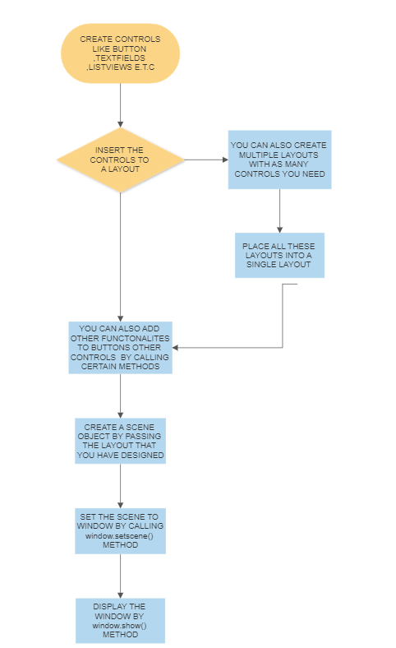
FLOW CHART

Slide 18
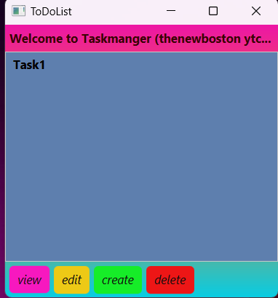
SCENE OF THE MAIN WINDOW
VBOX WITH A LABEL AT THE TOP OF BORDER PANE
LIST VIEW AT THE CENTER OF BORDER PANE
A HBOX WITH BUTTONS VIEW,EDIT,CREATE AND DELETE AT THE BOTTOM OF THE BORDER PANE

Slide 19
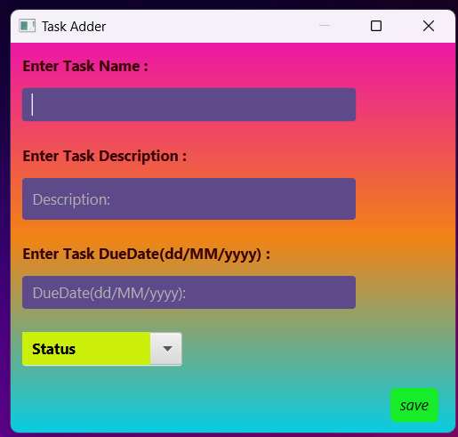
SCENE OF OTHER CHILD WINDOWS
1.
2.
3.
4.
5.
6.
7.
8.

Slide 20
THE ENTIRE SCENE IS GRIDPANE LAYOUT
1.TEXT LABEL AT (0,0)
2.TEXT FIELD AT (0,1)
3.TEXT LABEL AT (0,3)
4.TEXT FIELD AT (0,4)
5.TEXT LABEL AT (0,6)
6.TEXT FIELD AT (0,7)
7.CHOICE BOX AT (0,9)
8.BUTTON AT (3,11)

Slide 21
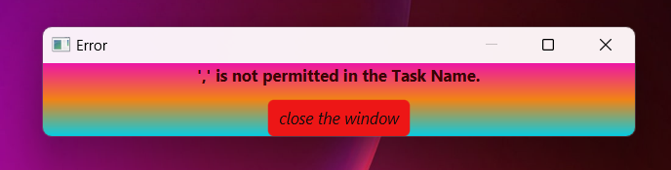
ALERT BOX SCENE
LABEL
BUTTON
VBOX

Slide 22


REFERENCES(THE NEWBOSTON YT)
FIRST VIDEO IN PLAYLIST
YOUTUBE CHANNEL LINK

Slide 23

THANK YOU!!!

